Slide 1

PYTHON MINI PROJECT
AI IMPACT ON JOBS BY 2030
1262252045 – Pournami Roy
1262253274 – Tanishka Tiwari
1262252891 – Palak Soni
1262250376 –Vrukshita Vinod
1262252177 –Prachiti Suryawanshi
Python Programming
Prof. Vidya Patil

Slide 2

Problem Statement
SECTION
1
2
3
By 2030, AI is expected to reshape the global workforce, automating up to one-third of existing jobs and transforming many others.
This project analyses a dataset of 3,000 job records to uncover patterns in automation risk, AI exposure, and skill requirements that will affect professions.
4
5
6
7
8

Slide 3

Objectives
SECTION
1
2
1. Perform exploratory data analysis to understand job patterns, automation risk, and skill structures.
2. Categorise job roles by automation risk (High/Medium/Low)
3. Identify relationships among AI exposure, education, experience, and job security.
4. Communicate insights using clear and effective visualisations
5. Clean and prepare the dataset for analysis
6. Engineer relevant features (e.g., total skills required)
7. Compare trends across job titles, education levels, and risk groups.
8. Provide data-driven recommendations for workforce planning.
3
4
5
6
7
8
9

Slide 4
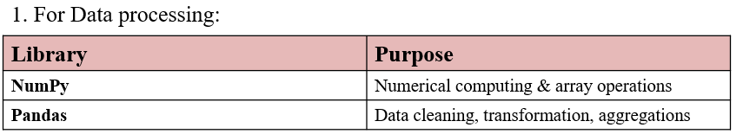
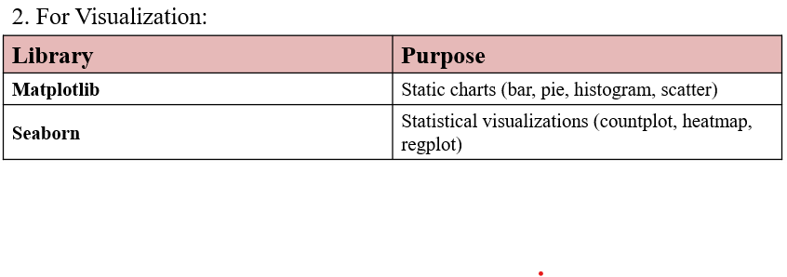
Methodology
SECTION
1
Tools and Libraries Used:-
2
3
4
5
6
7
8
9

Slide 5
Dataset Description
SECTION
1
2
Overview:
Comprehensive dataset analysing AI's impact on employment across 20 distinct job titles, featuring 3,000 records with 18
attributes spanning job characteristics, AI exposure metrics, and skill assessments.
Key Dimensions:
Records: 3,000 job profiles
Attributes: 18 columns
Job Categories: 20 unique positions
Data Quality: 100% complete (zero missing values)
Core Metrics:
Salary Range: $30,030 – $149,798 (avg: $89,372)
Experience: 0–29 years (avg: 14.7 years)
Education: 4 levels (High School, Bachelor's, Master's, PhD)
AI Exposure Index: 0.0–1.0 (avg: 0.50)
Automation Risk by 2030: 5%–95% probability
Risk Classification:
3 categories: Low, Medium, High automation risk
Skill Assessment:
10 competency scores (0.0–1.0) measuring technical & soft skills
3
4
5
6
7
8
9

Slide 6
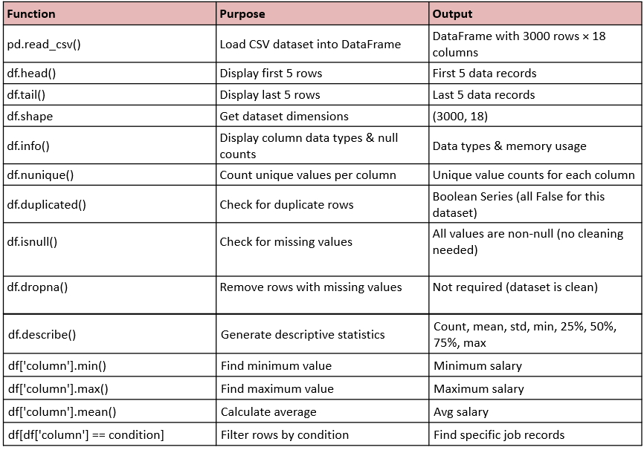
Functions used
SECTION
1
2
3
4
5
6
7
8
9

Slide 7
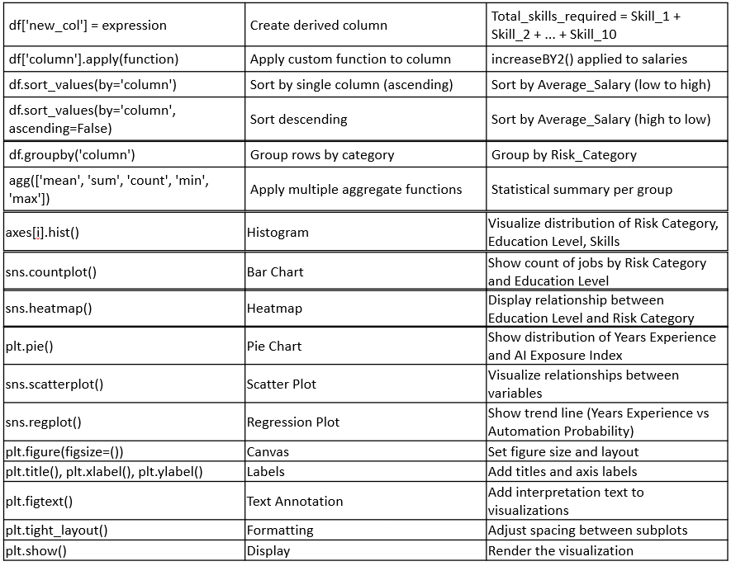
1
2
3
4
4
5
6
7
8
9

Slide 8
Workflow
SECTION
1
2
START
↓
[SECTION 1] Import Required Libraries
↓
[SECTION 2] Load & Inspect Dataset
↓
[SECTION 3] Data Cleaning
↓
[SECTION 4] Statistical Cleaning
↓
[SECTION 5] Features and Sorting
↓
[SECTION 6] Grouping and Aggregation
↓
[SECTION 7] Analysis and Insights
3
4
5
6
7
8
9

Slide 9
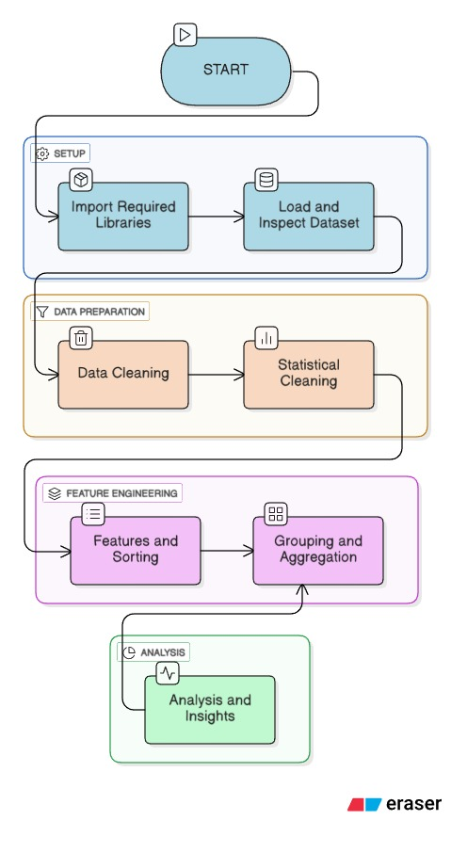
Flowchart
SECTION
1
2
3
4
5
6
7
8
9

Slide 10
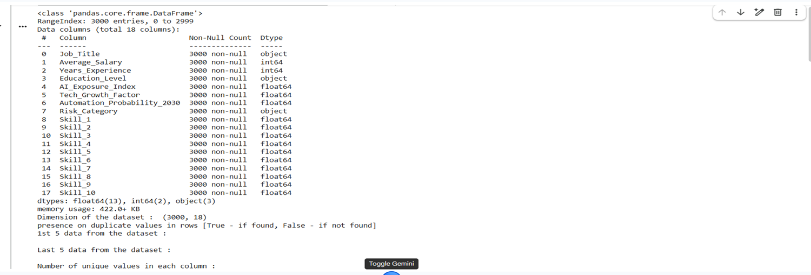
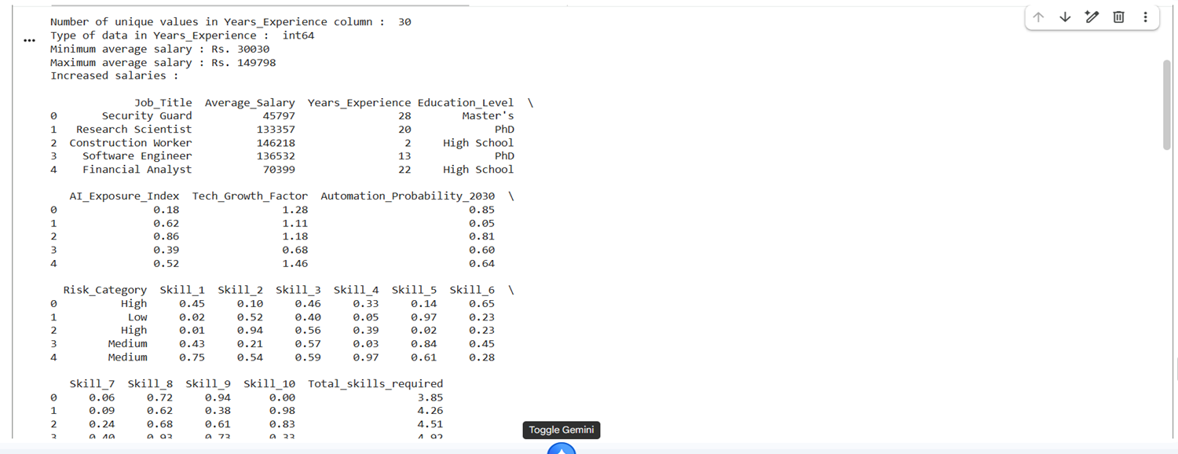
Output
SECTION
1
2
3
4
5
6
7
8
9

Slide 11
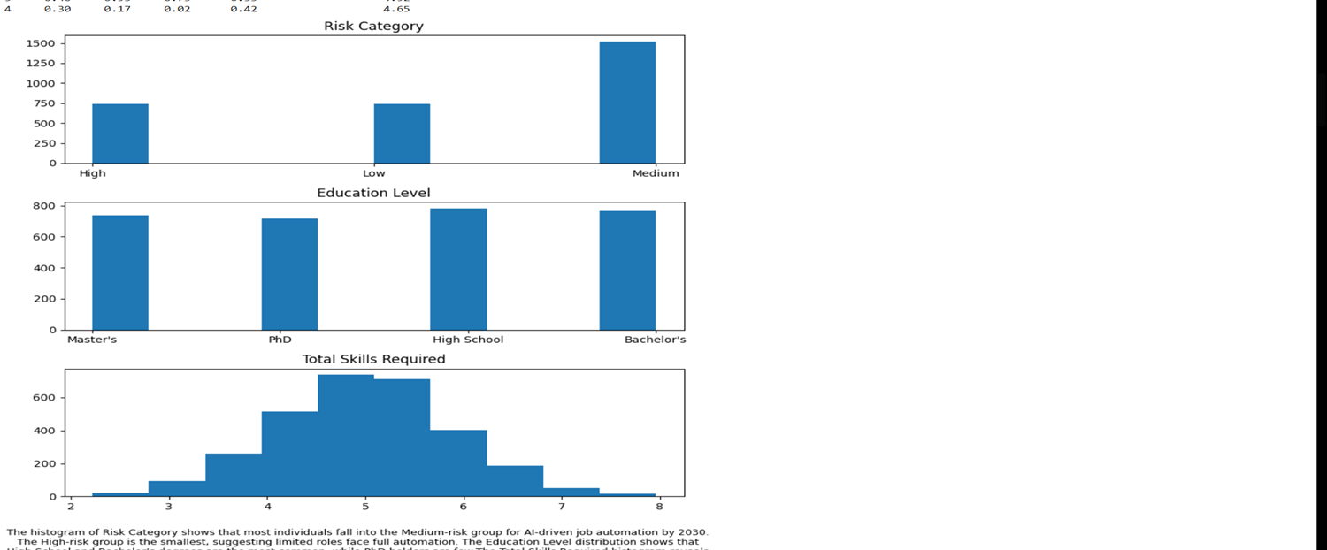
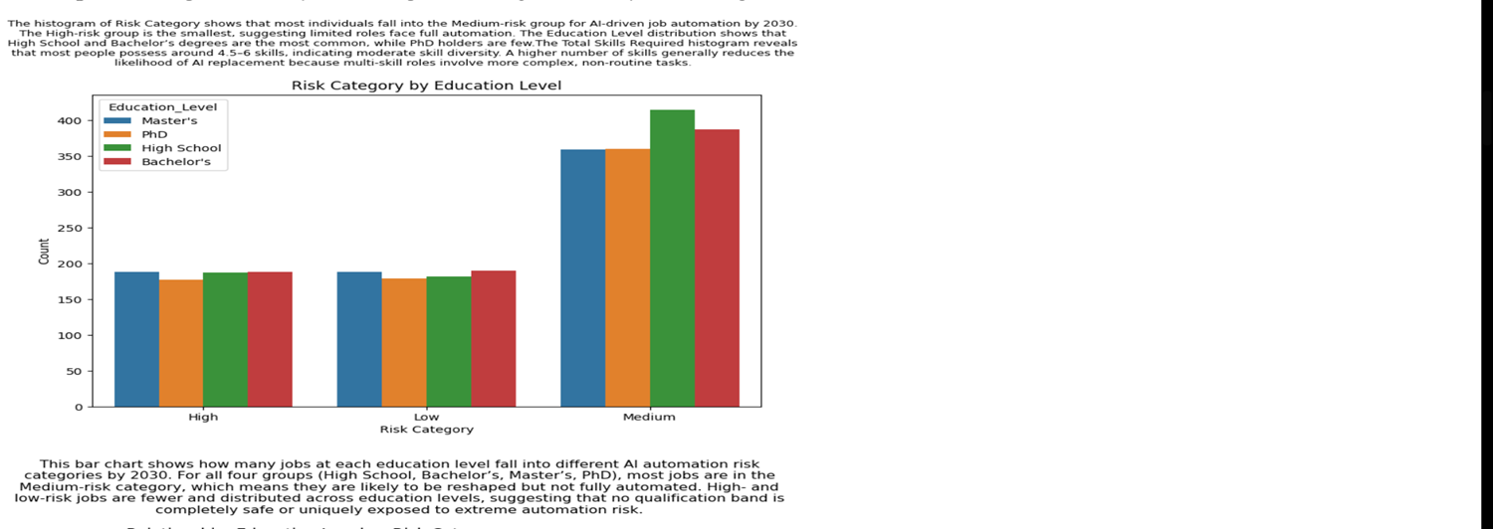
SECTION
1
2
3
4
5
6
7
8
9

Slide 12
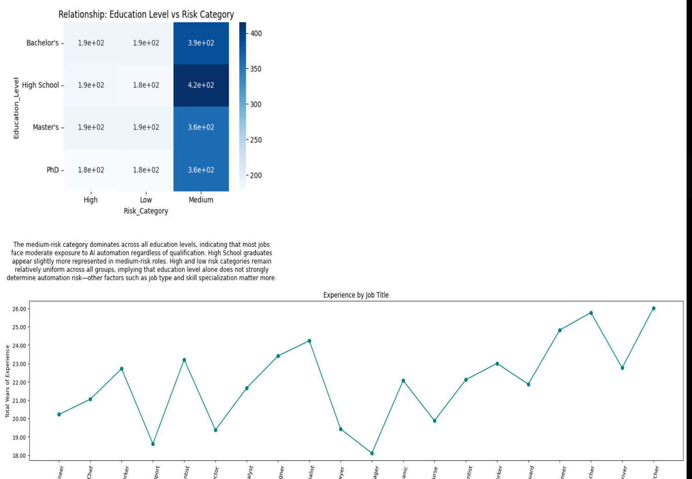
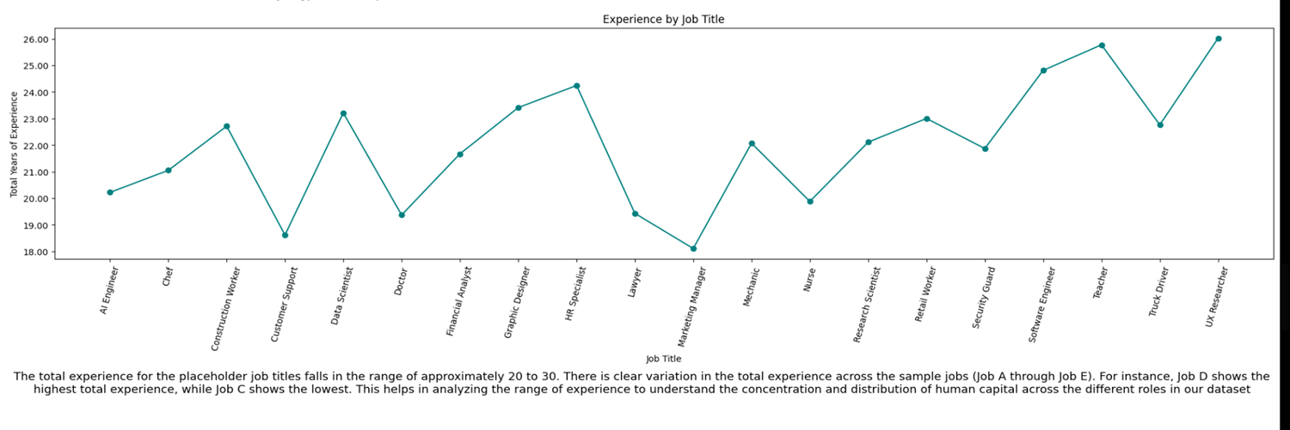
SECTION
1
2
3
4
5
6
7
8
9

Slide 13
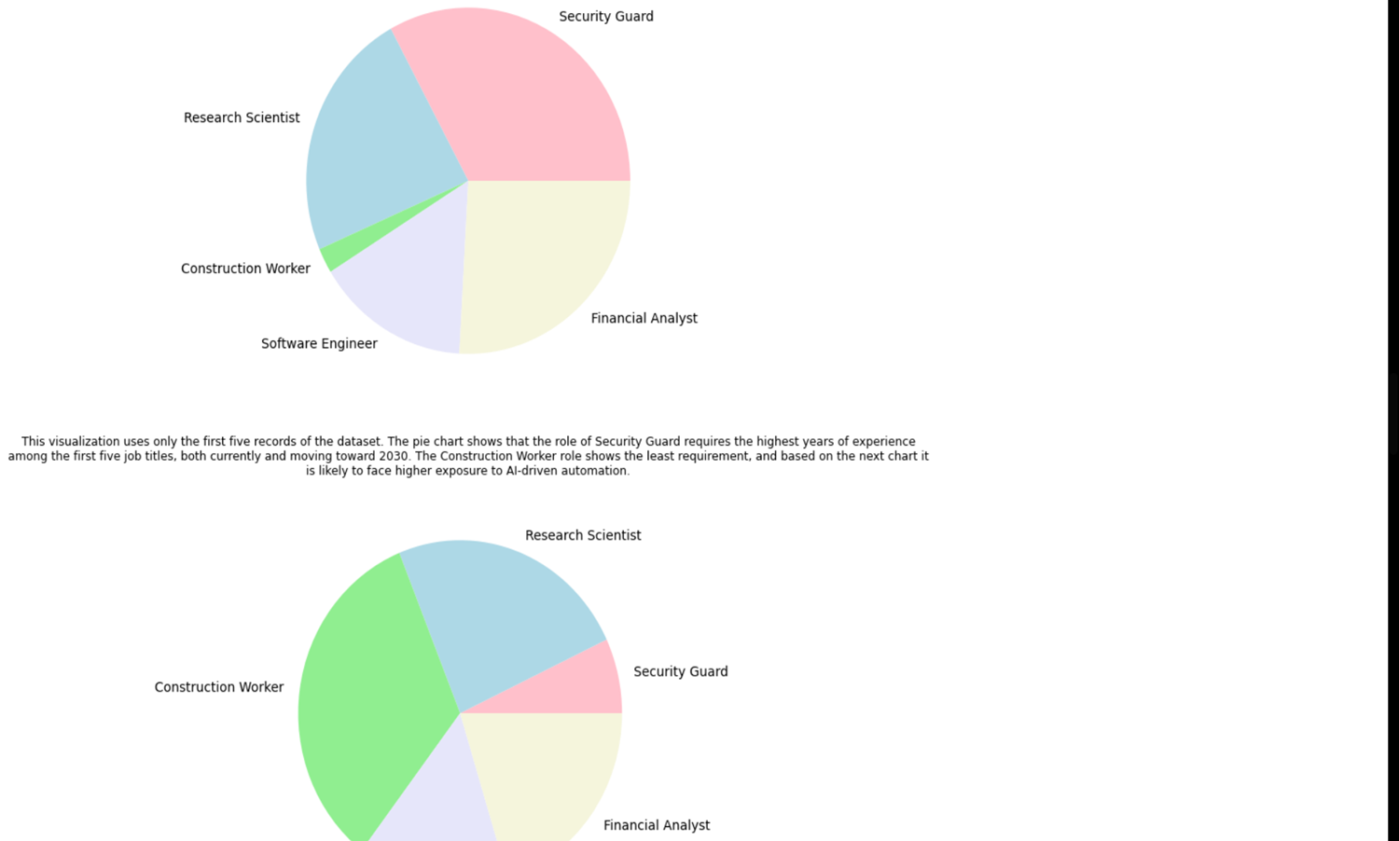
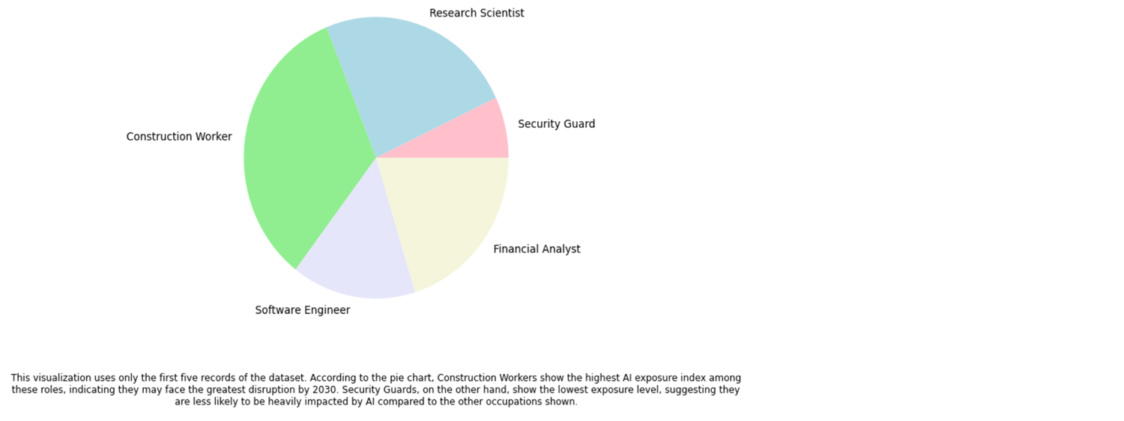
SECTION
1
2
3
4
5
6
7
8
9

Slide 14
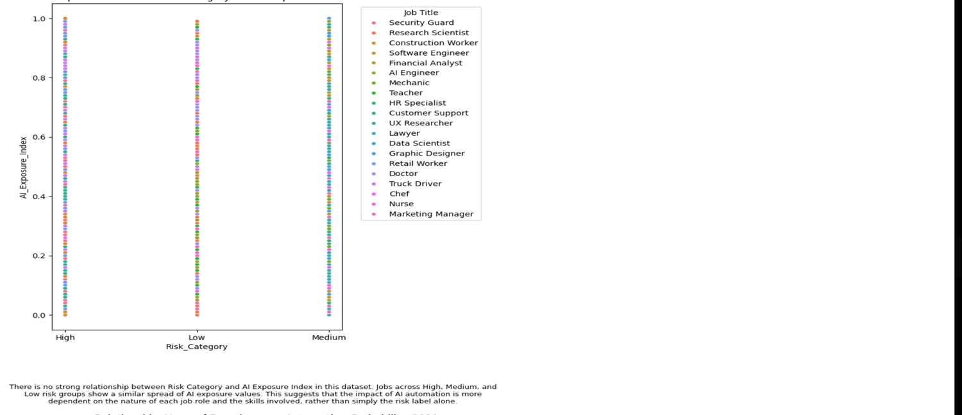
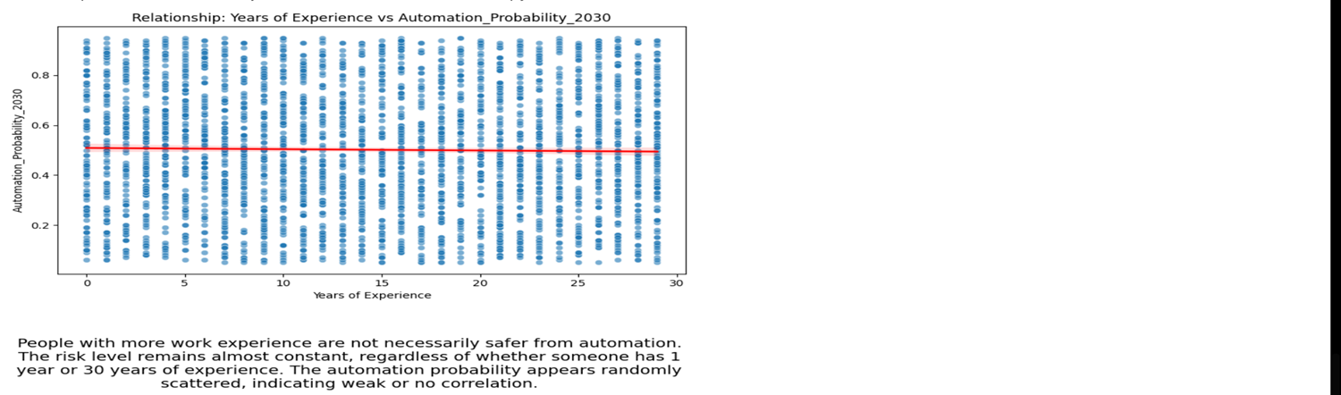
SECTION
1
2
3
4
5
6
7
8
9

Slide 15
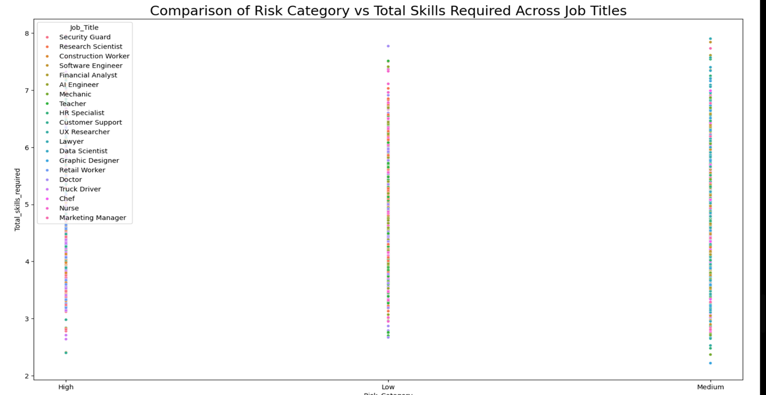
SECTION
1
2
3
4
5
6
7
8
9

Slide 16
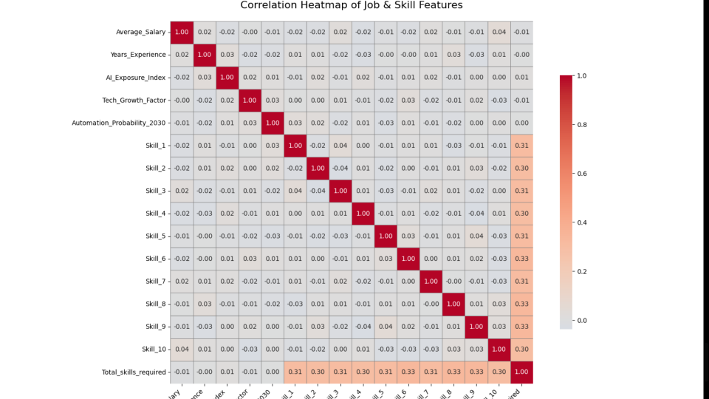
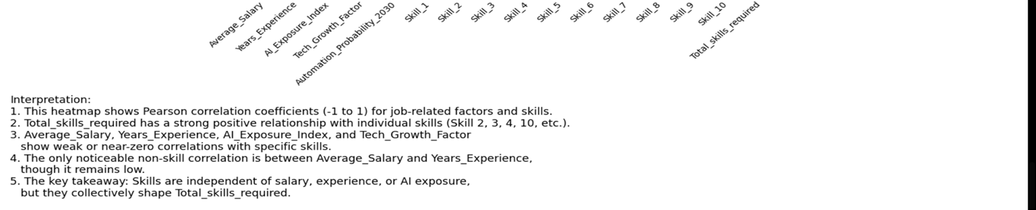
SECTION
1
2
3
4
5
6
7
8
9

Slide 17
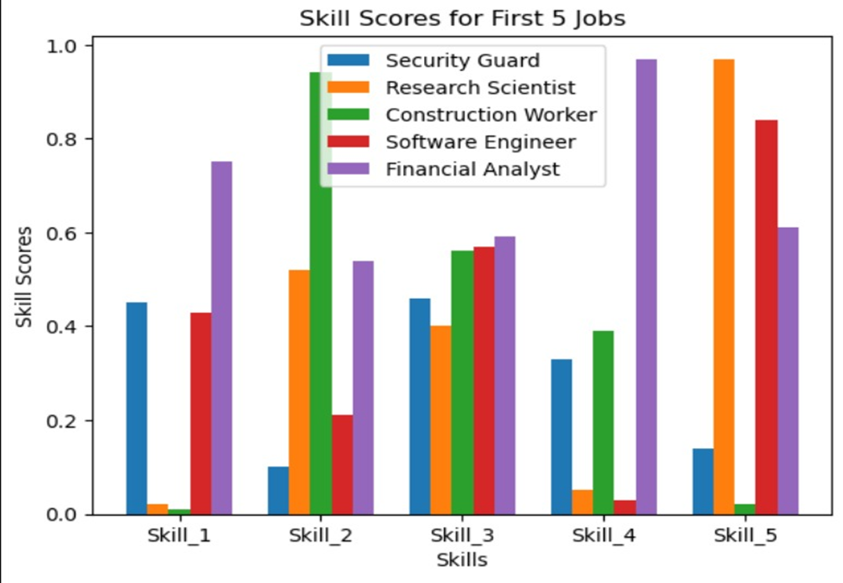
SECTION
1
2
3
4
5
6
7
Interpretation:
•Each job has a distinct skill profile. No two jobs rely on the same combination of skills.
•Research Scientist and Financial Analyst have skills that peak very high in certain categories, showing specialization.
•Construction Worker has the sharpest contrast between a very high skill (Skill_2) and very low ones, showing focused skill dependency.
•Software Engineer has a more balanced skill distribution, especially across Skills 3-5.
•Security Guard shows moderate needs across most skills without extreme highs or lows.
8
9

Slide 18
Conclusion
SECTION
AI is set to reshape roles far more than it will erase them. Roughly 50.7% of jobs are likely to be transformed, not simply eliminated, by new automation and augmentation tools.
Actionable recommendations:
•Workers: Build complementary skill stacks such as coding/data literacy, critical thinking, creativity, and interpersonal skills. Pursue continuous micro-learning and cross-disciplinary experience to increase resilience.
•Employers: Invest in targeted upskilling, redesign jobs to pair human strengths with AI, and create transition roles that capture new value (e.g., AI supervisors, data translators).
•Policymakers & educators: Update curricula toward problem-solving, digital fluency, and lifelong learning pathways; fund retraining programs and safety nets to ease sectoral transitions.
Bottom line: The next decade favours adaptability. With timely investment in diverse skills, responsible deployment by organisations, and supportive public policy, AI can be a tool for role evolution and new opportunities rather than wholesale job loss.
1
2
3
4
5
6
7
8
9

Slide 19
Refrences
SECTION
1
  https://www.kaggle.com/datasets/khushikyad001/ai-impact-on-jobs-2030
  https:/papers.ssrn.com/sol3/Delivery.cfm/5213331.pdf?abstractid=5213331&mirid=1
  https://app.eraser.io/team/create (for flowchart)
  https://www.geeksforgeeks.org/machine-learning/best-python-libraries-for-machine-learning/
2
3
4
5
6
7
8
9

Slide 20


THANK YOU

